Slide 1

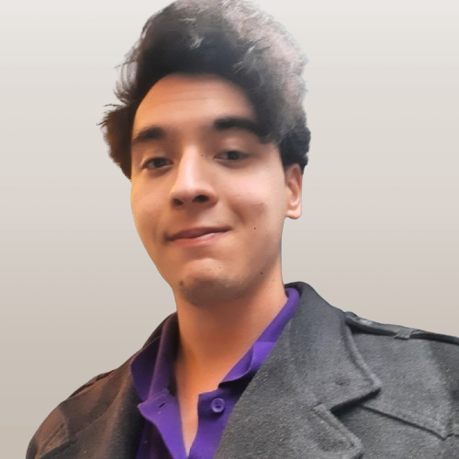
Nazim Atakan Erdogan (he/him) Curriculum Vitae
Summary

Slide 2
About me:
I am a computer engineering student at the RWTH Aachen University, who has a strong interest in data related fields. I used to be a medical student at the University of Cologne and graduated from one of the top schools of my country with a top GPA. I scored at the top 1% by the aptitude test for studies in Germany and I believe that would prove my analytical capabilities. I left medical school as I hated memorization of facts instead of being creative and I missed maths a lot. Although I love healthcare and health related sciences I would like to look to medicine from an analyst’s perspective.
My interest in data science was developed by my interest for self development and psychology actually. A course I have taken at Uni Köln was eye opening and sparked my interest to analytics-psychology combination. I started to learn about HR and people analytics and realized I can use my medical terminology knowledge and insights about medical sciences to support doctors and healthcare professionals from a data scientist’s perspective.
I am also interested in economics. I also took part at the economics-social sciences related track of the national university exam in Turkey and scored pretty high, enough for admission to the top universities in Turkey, even though my original track was science and math.
Although I have been building projects since quite recent times, I learn fast and love disciplined work. My internship at ELEVATE LABS, which I am pursuing now, gives me responsibility with daily tasks on data cleaning, visualization and querying. And training and internships by Oeson and Edureka support my professional development and give me a foundational knowledge on data science and analytics.
I am passionate about data science as I like to practice it, it is kind of lifestyle for mine, I can spend a whole night coding or pursue a Tableau or Power BI project in which I find a vision.
Even though I am pretty new to this field, I eager to learn fast and want to learn more about data and data related tools.
I am hoping that you consider my application and give me a chance on my professional way towards being a data scientist/analyst.
With the kindest regards,
Nazim Atakan Erdogan

Slide 3
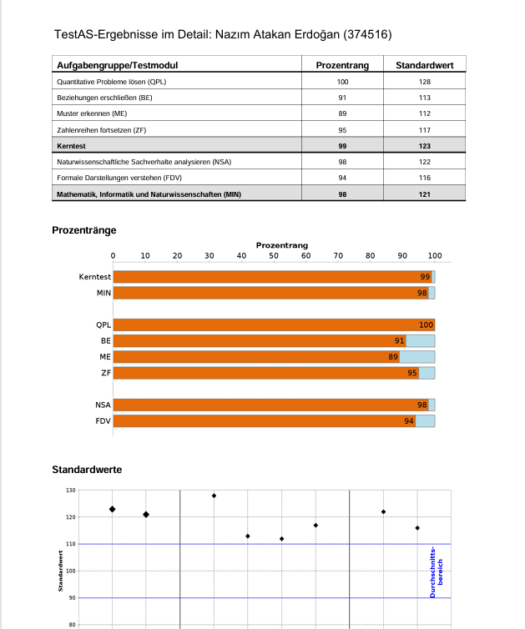
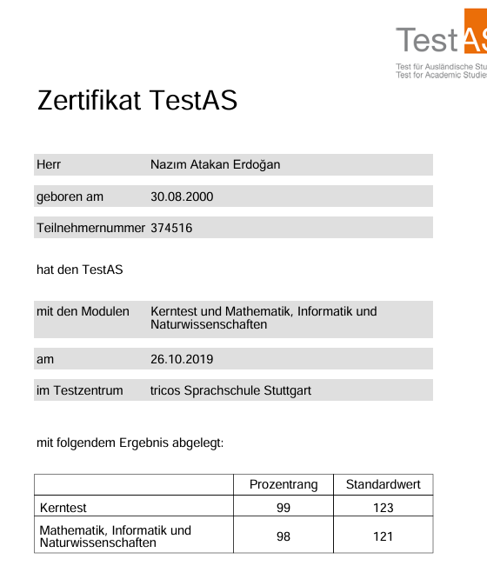


Slide 4

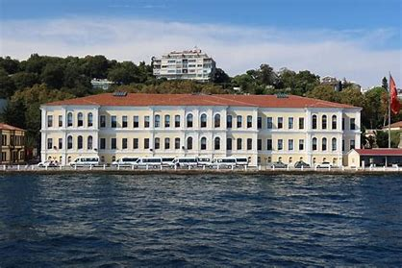

EDUCATIONAL BACKGROUND
HIGH SCHOOL:
Kabatas Erkek Lisesi (2014-2019)
https://www.pasch-net.de/de/pasch-
schulen/schulportraets/europa/tur/kabatas-erkek-
lisesi.html
- One of the best schools in Turkey, also a german partner school, graduated with 96% GPA and 1,5
(Abitur equivalent), scored top 0.1% at the national
turkish university entrance exam for economics
and social sciences, top 0.8% in science and mathematics. Also graduated with Deutsches Sprachdiplom C1 der KMK
MEDICAL SCHOOL
Bezmialem Vakif University (2019-2020)
Studienstart International
University of Cologne (2020-2020)
MEDICAL SCHOOL
University of Cologne (2020-2022)
Ongoing Bachelor’s degree:
RWTH Aachen University (since 2022), Computer Engineering
Dropped out voluntarily, as I wanted to study something related
mathematics and physics

Slide 5


Online Courses and Trainings
Alongside with remote trainings and internships from various companies, I also complete online courses to improve myself and enhance my professional understanding of data science.
I am taking some of these courses in Portuguese and Italian to improve my international understanding of business and data.
https://www.coursera.org/learner/atakanerdogan
www.linkedin.com/in/atakanerdogan1 – for Linkedin learning certificates

Slide 6

Data Analysis & Science Related Experience
TRAININGS & INTERNSHIPS
ELEVATE LABS (since Apr 2025) -remote
Data Analyst Intern
Building projects and completing tasks daily to process and visualize data.
Edureka.co (since Jan 2025) - remote
DS/ML Internship Program of Edureka.co, getting remote training with building different projects. Latest project was heart disease prediction.
Oeson (since Mar 2025) - remote
Oeson Global Data Science Training and Internship Program
Getting training and applying my skills hands on real time, and with building different projects. I have built a “Revenue Prediction” project.
Oeson (Nov 2024-Mar 2025) - remote
Oeson Global Data Analytics Training and Internship Program
My first experience in data field, the training and internship gave me a good foundation and sparked my interest to learn more about data analytics and science. I got training and applied skills hands-on in Excel, Python, SQL, and Tableau. I had built different projects for each skill

Slide 7
Github
https://github.com/atakanerdogn
https://github.com/atakanerdogn/DATA-since-9-April
- Data projects since 9th April 2025, working on nearly 20 different projects
https://github.com/atakanerdogn/Health-Data-Projects
Health-Medicine related projects
https://github.com/atakanerdogn/Edureka-DS-ML-Internship- Program/blob/main/edureka_heart_disease%20(11).ipynb
Heart Disease Project, Edureka Training/Internship

Slide 8

Medicine and Biotechnology Related Experience
Assistant of local officer on research exchange at Turkish Medical Students’ International Committee, a NGO, helped by organisation of events and seminars for medical students (2019-2020)
Completed observership & internship at Beykoz Institute of Life Sciences and Biotechnology in Istanbul on Malaria research, gained hands-on experience on molecular biology methods and animal experiments and biological data gathering (Feb 2020)
Completed observership & internship at Umit Hospital Eskisehir, Turkey: gained experience on patient data gathering, and data management at the nurse station, also participated at doctor visits and consultations. (Mar 2021)

Slide 9
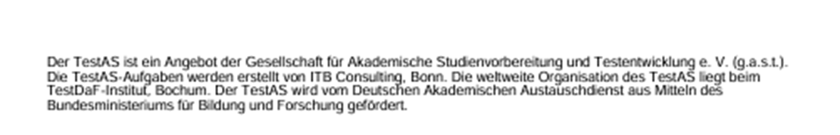
RELEVANT LINKS
https://www.pasch-net.de/de/pasch-schulen/schulportraets/europa/tur/kabatas-erkek-lisesi.html
https://www.coursera.org/learner/atakanerdogan
https://www.linkedin.com/in/atakanerdogan1
https://github.com/atakanerdogn/DATA-since-9-April/tree/main
https://www.testas.de/de/

